Slide 1

COMP-SCI 5590 - 0003 Special Topics
Mobile App Development

Slide 2
Agenda
Layouts
Views
Intents

Slide 3
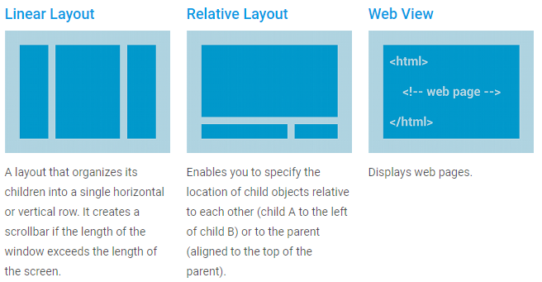
Layout

Slide 4
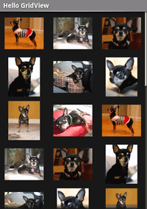
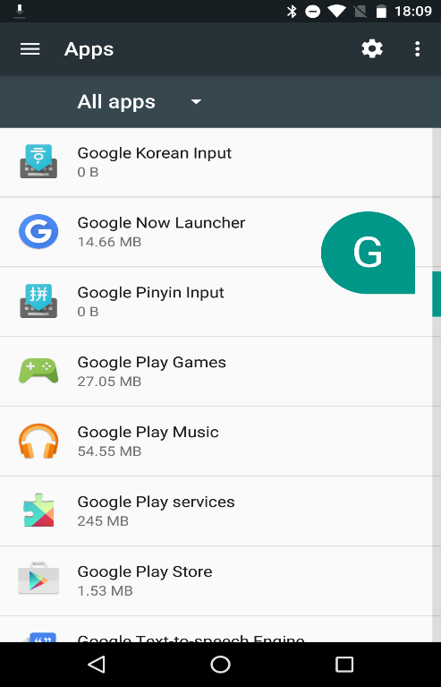
Layouts with Adapter

Slide 5
Layouts with Adapter
Used when content of layout is dynamic or not pre-determined
Adapter binds data to layout. It retrieves the data and converts each entry into a view that can be added

Slide 6
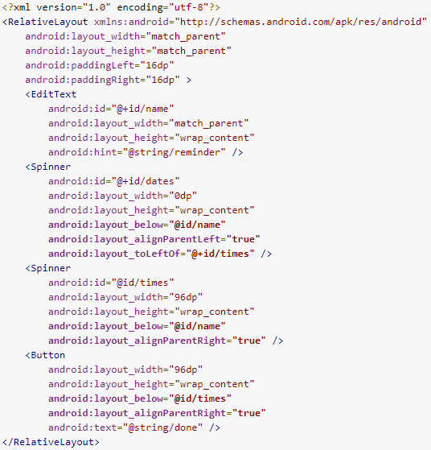
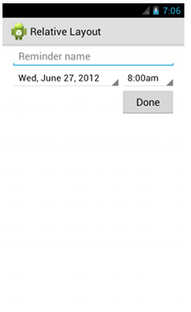
Relative Layout

Slide 7
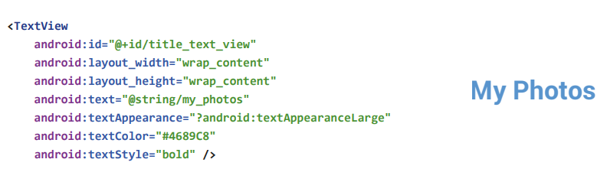
TextView
Displays text

Slide 8
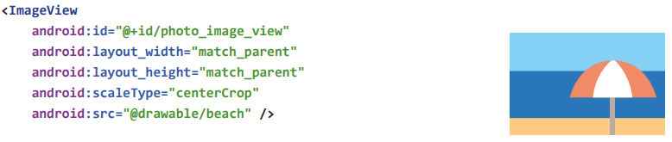
ImageView
Displays image

Slide 9

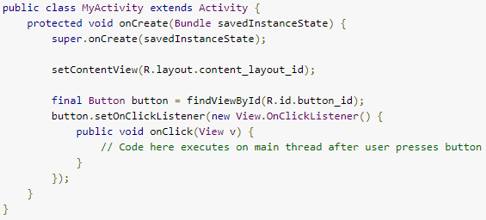
Button
https://developer.android.com/reference/android/widget/Button.html

Slide 10
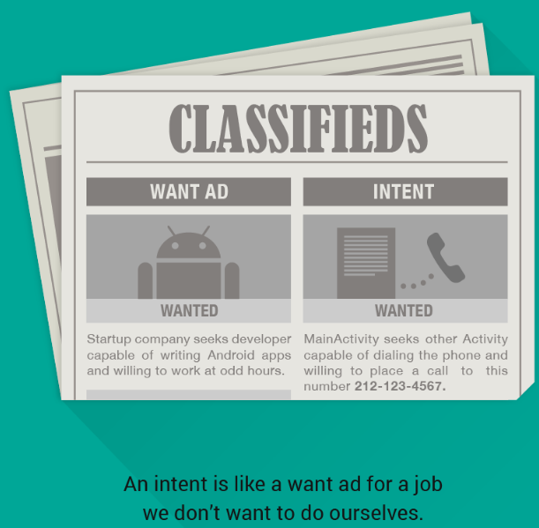
Intent

Slide 11
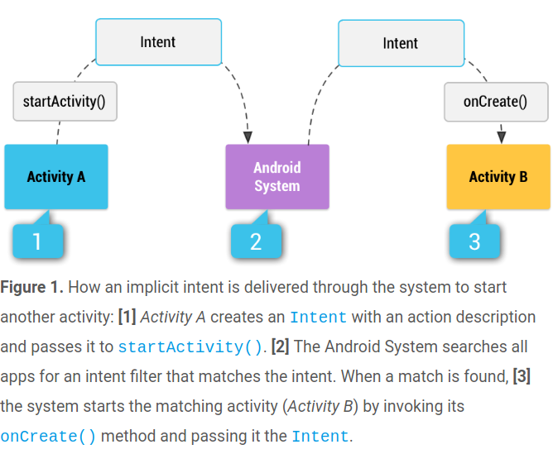
Intent

Slide 12
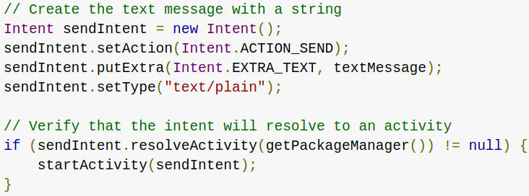
Implicit intent
do not name a specific component, but instead declare a general action to perform

Slide 13
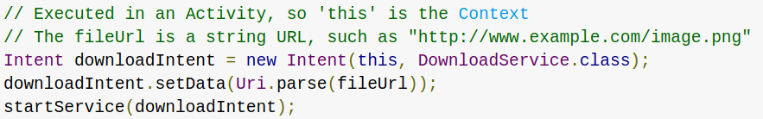
Explicit Intent
specify the component to start by name (the fully-qualified class name)

Slide 14
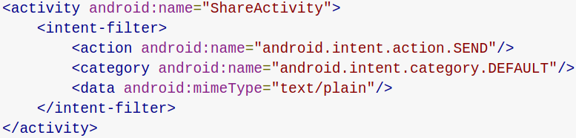
Intent Filter
an expression in an app's manifest file that specifies the type of intents that the component would like to receive

Slide 15
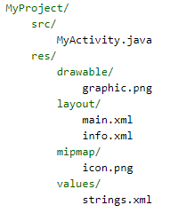
Resources

Slide 16
Accessing Resources in Code
Syntax: [<package_name>.]R.<resource_type>.<resource_name>
<package_name> name of the package in which the resource is located (not required when referencing resources from your own package).
<resource_type> the R subclass for the resource type.
<resource_name> is either the resource filename without the extension or the android:nameattribute value in the XML element (for simple values).

Slide 17
R Class
Generated when the application is compiled,
Contains resource IDs for all the resources in res/ directory.
For each type of resource, there is an R subclass (e.g. R.drawable for all drawable resources)
For each resource of that type, there is a static integer (e.g: R.drawable.icon). This integer is the resource ID that you can use to retrieve your resource

Slide 18
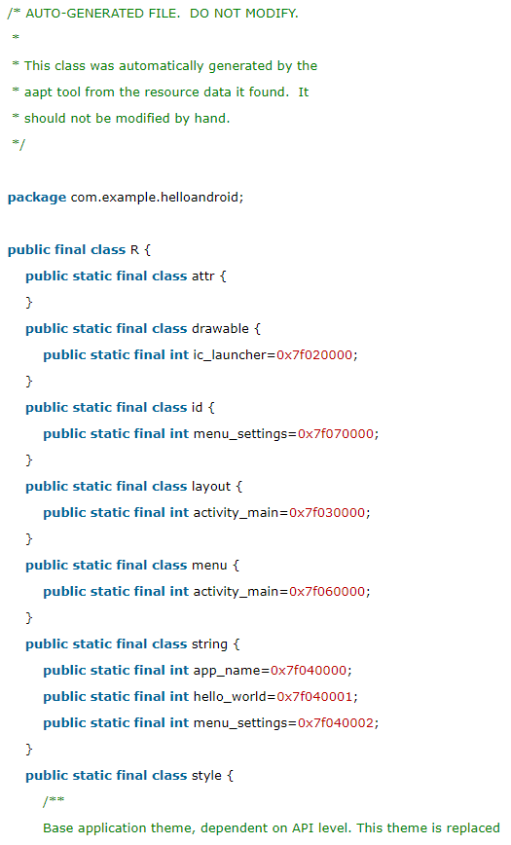
R Class
Location: Project/app/build/generated/source/r/debug/<your package name>/R.java

Slide 19
In Class Programming
From the coffee ordering app create a pizza ordering app
Add two more options for the toppings
Add two button in the main activity . One for viewing the order in a new activity and the other for sending the order through email
Make sure that each activity has appropriate name
Change the content of the activity that displays the order such that each item is accompanied with a suitable image

Slide 20
References
https://developer.android.com/index.html
https://developers.google.com/android/for-all/vocab-words/
https://classroom.udacity.com/courses/ud836

